Slide 1
APPLICATIONS TO PHYSICS AND ENGINEERING

Slide 2
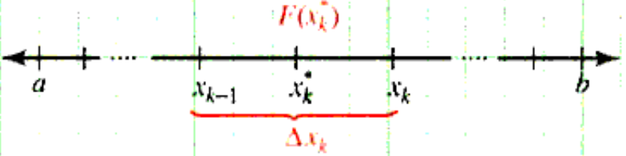
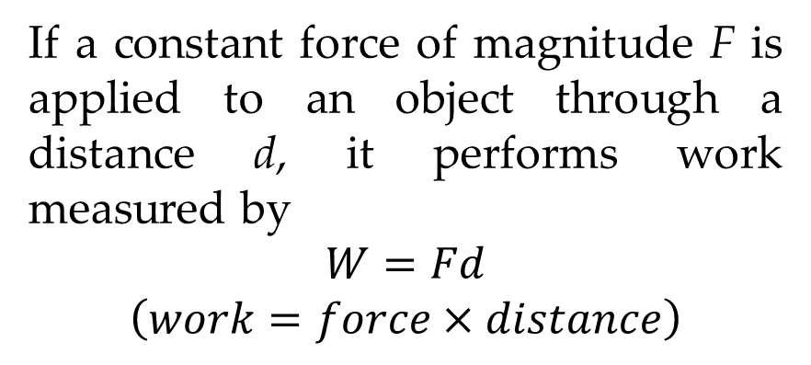
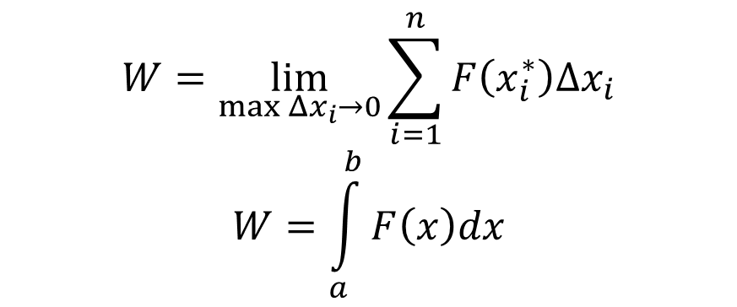
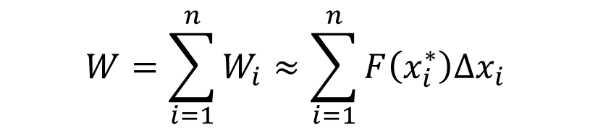
Work
If a constant force of magnitude F is applied to an object through a distance d, it performs work measured by
$$W=Fd$$
$$\left(work=force×distance\right)$$
Common units of Work and Force
Mass | Distance | Force | Work
kg | m | newton (N) | joule (J)
g | cm | dyne (dyn) | erg
slug | ft | Pound (lb) | ft-lb
Suppose a continuous function F is a variable force acts on an object moving along the x-axis from x = a to x = b.
$$W=\sum_{i=1}^{n}{W_{i}}≈\sum_{i=1}^{n}{F\left(x_{i}^{∗}\right)Δx_{i}}$$
$$W=\lim_{\max{Δx_{i}→0}}{\sum_{i=1}^{n}{F\left(x_{i}^{∗}\right)Δx_{i}}}$$
$$W=\int_{a}^{b}{F\left(x\right)dx}$$

Slide 3
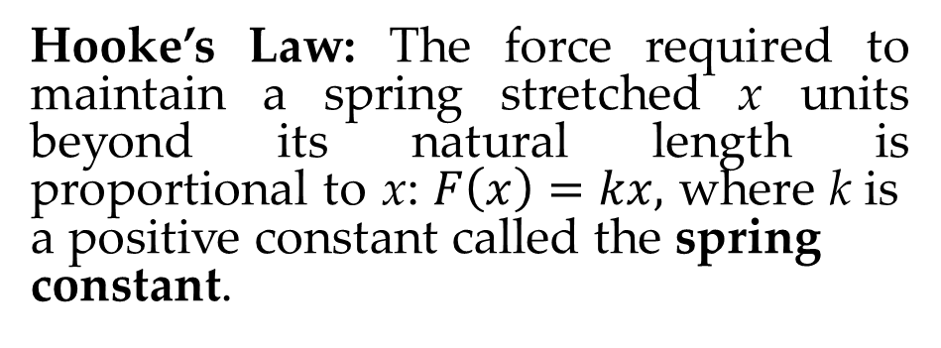
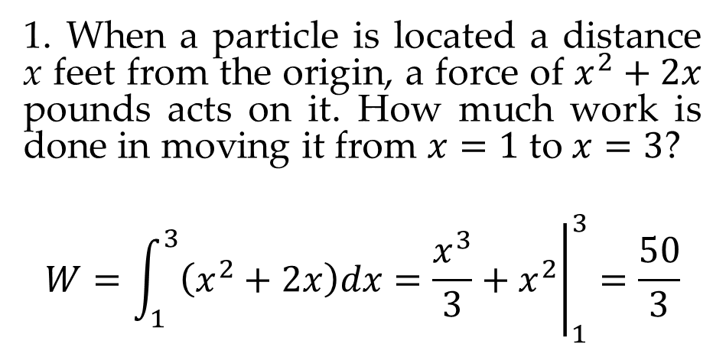
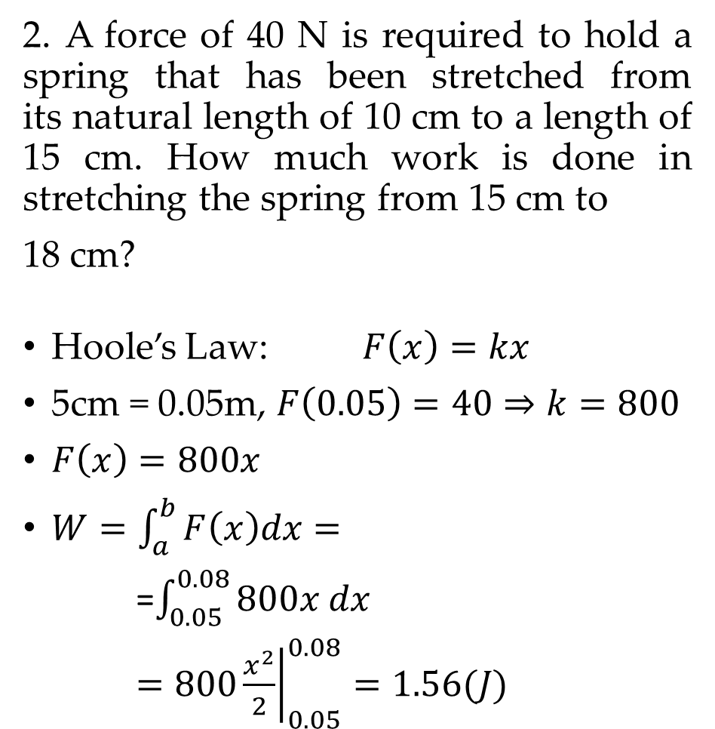
EXAMPLES
1. When a particle is located a distance x feet from the origin, a force of $x^{2}+2x$ pounds acts on it. How much work is done in moving it from $x=1$ to $x=3$?
$$W=\int_{1}^{3}{\left(x^{2}+2x\right)dx}={\left.\frac{x^{3}}{3}+x^{2}\right|}_{1}^{3}=\frac{50}{3}$$
2. A force of 40 N is required to hold a spring that has been stretched from its natural length of 10 cm to a length of 15 cm. How much work is done in stretching the spring from 15 cm to
18 cm?
Hoole’s Law: $F\left(x\right)=kx$
5cm = 0.05m, $F\left(0.05\right)=40⇒k=800$
$F\left(x\right)=800x$
$W=\int_{a}^{b}{F\left(x\right)dx=}$
=$\int_{0.05}^{0.08}{800x dx}$
$={\left.800\frac{x^{2}}{2}\right|}_{0.05}^{0.08}=1.56(J)$
Hooke’s Law: The force required to maintain a spring stretched x units beyond its natural length is proportional to x: $F\left(x\right)=kx,$ $\text{where} \text{k} \text{is} \text{a} \text{positive} \text{constant} \text{called} \text{the} \text{spring} \text{constant}\text{.}$

Slide 4
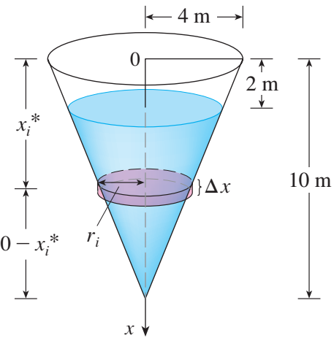
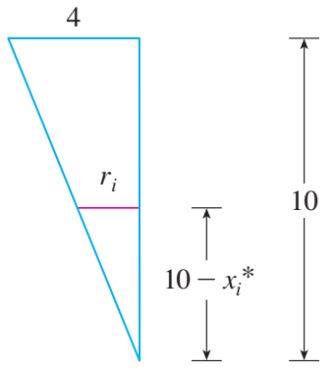
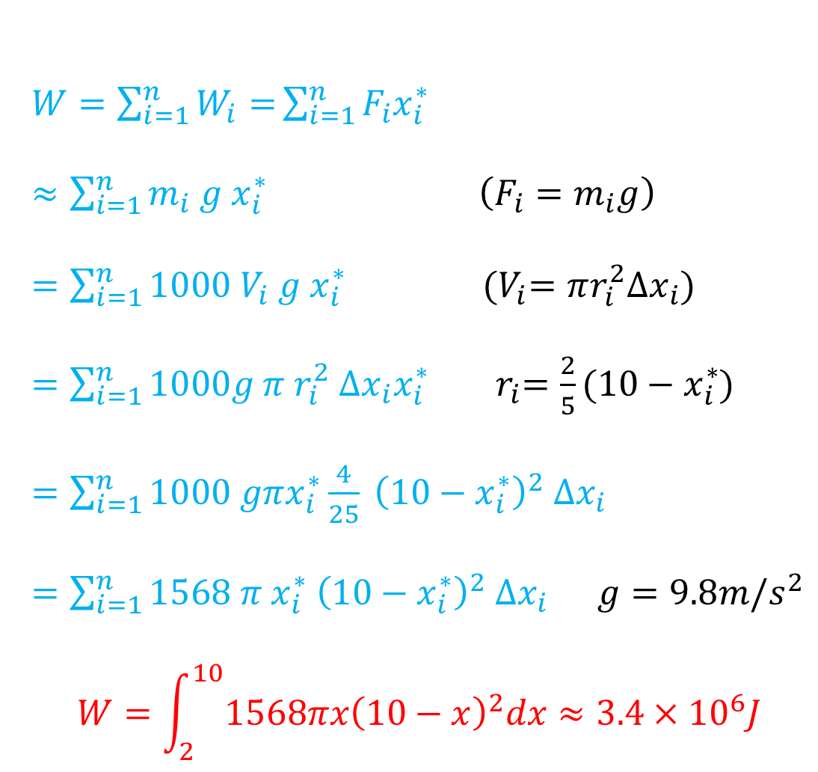
MODELING: PUMPING WATER OUT OF TANK
A tank has the shape of an inverted circular cone with height 10 m and base radius 4 m. It is flled with water to a height of 8 m. Find the work required to empty the tank by pumping all of the water to the top of the tank. (The density of water is 1000kg/m³.)
$W=\sum_{i=1}^{n}{W_{i}=}\sum_{i=1}^{n}{F_{i}x_{i}^{∗}}$
$≈\sum_{i=1}^{n}{m_{i} g{ x}_{i}^{∗}} \left(F_{i}=m_{i}g\right)$
$=\sum_{i=1}^{n}{1000{ V}_{i} g{ x}_{i}^{∗}}$ ${ (V}_{i}=πr_{i}^{2}Δx_{i})$
$=\sum_{i=1}^{n}{1000g π r_{i}^{2} Δx_{i}x_{i}^{∗}}$ ${ r}_{i}=\frac{2}{5}(10−x_{i}^{∗}$)
$=\sum_{i=1}^{n}{1000 gπx_{i}^{∗}\frac{4}{25} {\left(10−x_{i}^{∗}\right)}^{2} Δx_{i}}$
$=\sum_{i=1}^{n}{1568 π{ x}_{i}^{∗} {\left(10−x_{i}^{∗}\right)}^{2} Δx_{i}}$ $g=9.8m/s^{2}$
$$W=\int_{2}^{10}{1568πx{\left(10−x\right)}^{2}dx≈3.4×{10}^{6}J}$$

Slide 5
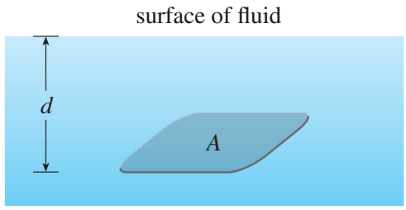
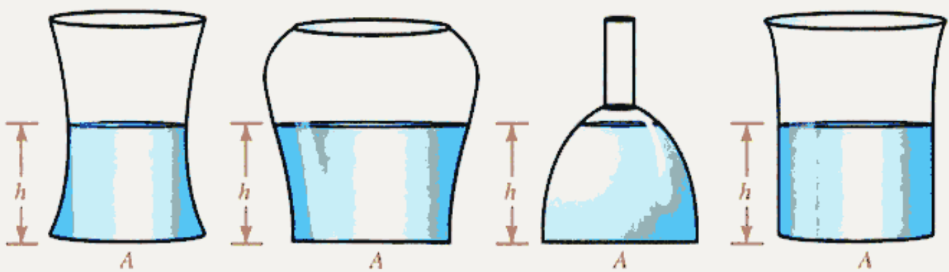
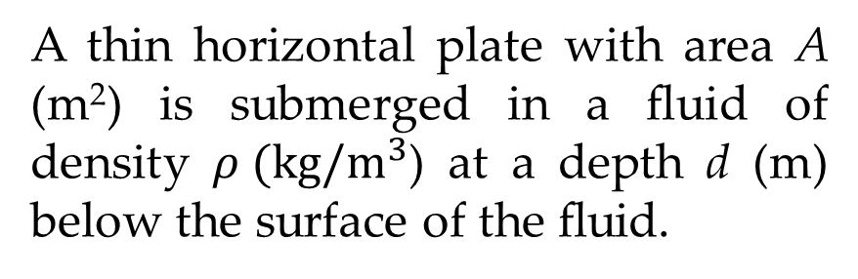
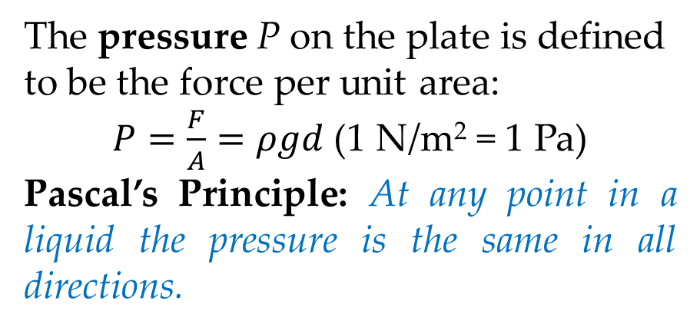
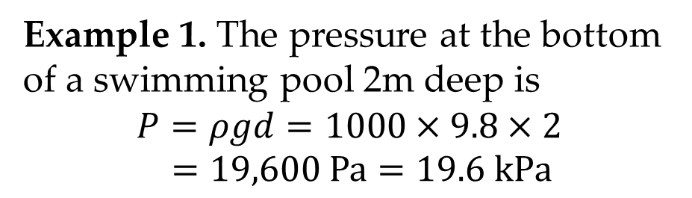
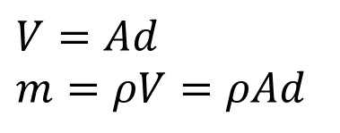
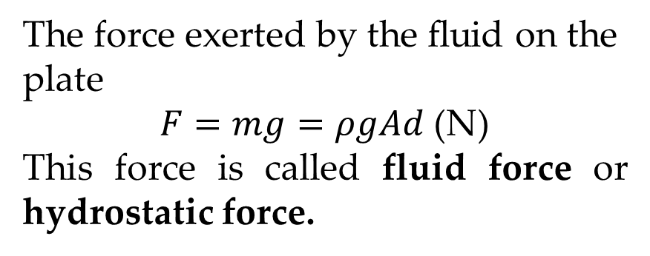
MODELING: FLUID PRESSURE AND FORCE
A thin horizontal plate with area A (m²) is submerged in a ﬂuid of density $ρ (kg/m^{3}$) at a depth d (m) below the surface of the ﬂuid.
The pressure P on the plate is defined to be the force per unit area:
$P=\frac{F}{A}=ρgd$ (1 N/m² = 1 Pa)
Pascal’s Principle: At any point in a liquid the pressure is the same in all directions.
$$V=Ad$$
$$m=ρV=ρAd$$
The force exerted by the ﬂuid on the plate
$F=mg=ρgAd$ (N)
This force is called fluid force or hydrostatic force.
Example 1. The pressure at the bottom of a swimming pool 2m deep is
$$P=ρgd=1000×9.8×2$$
$$=19,600 Pa=19.6 kPa$$

Slide 6
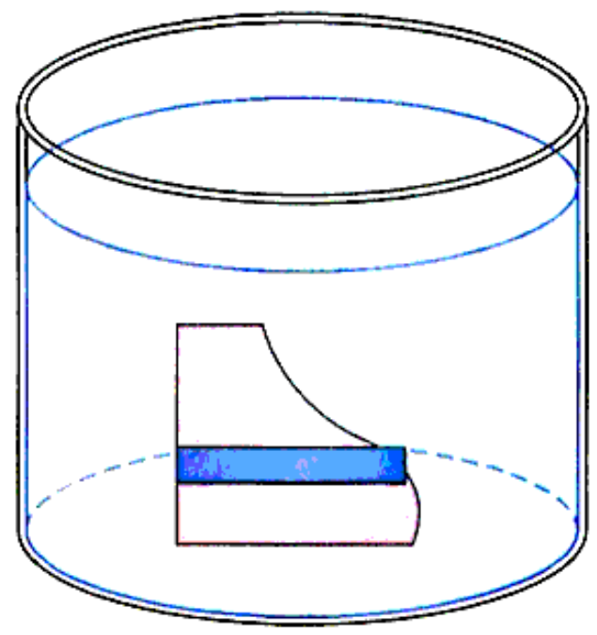
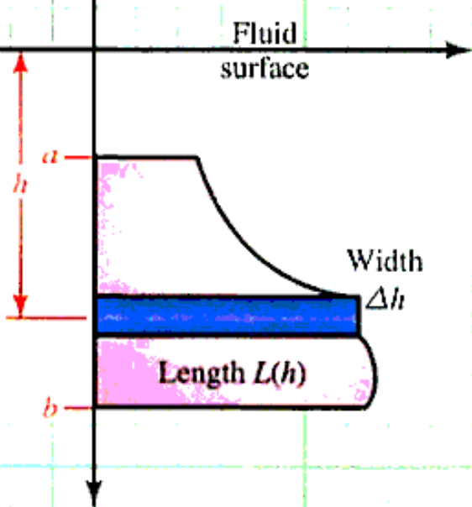
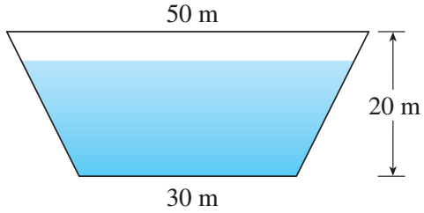
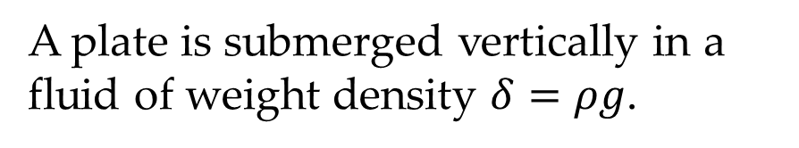
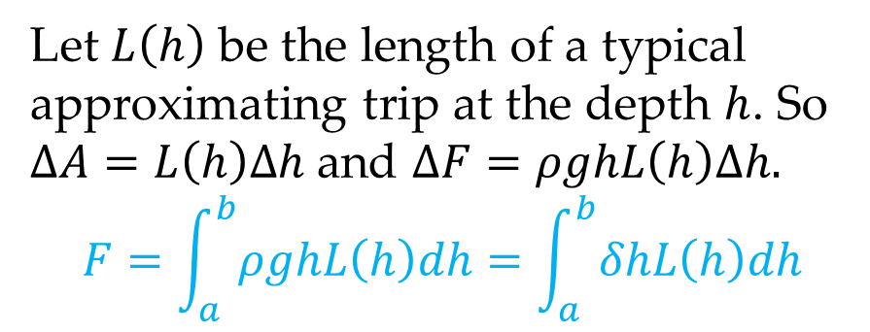
FLUID FORCE ON A VERTICAL SURFACE
A plate is submerged vertically in a fluid of weight density $δ=ρg$.
Example 2. A dam has the shape of the trapezoid. The height is 20 m and the width is 50 m at the top and 30 m at the bottom. Find the force on the dam due to hydrostatic pressure if the water level is 4m from the top of the dam.
Let $L\left(h\right)$ be the length of a typical approximating trip at the depth $h$. So $ΔA=L\left(h\right)Δh$ and $ΔF=ρghL\left(h\right)Δh.$
$$F=\int_{a}^{b}{ρghL\left(h\right)dh}=\int_{a}^{b}{δhL\left(h\right)dh}$$

Slide 7
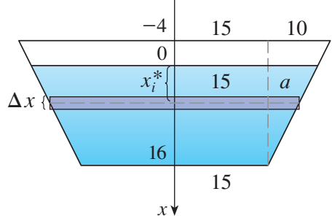
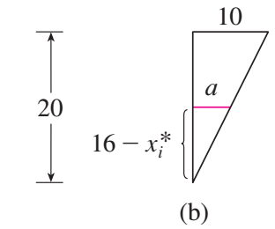
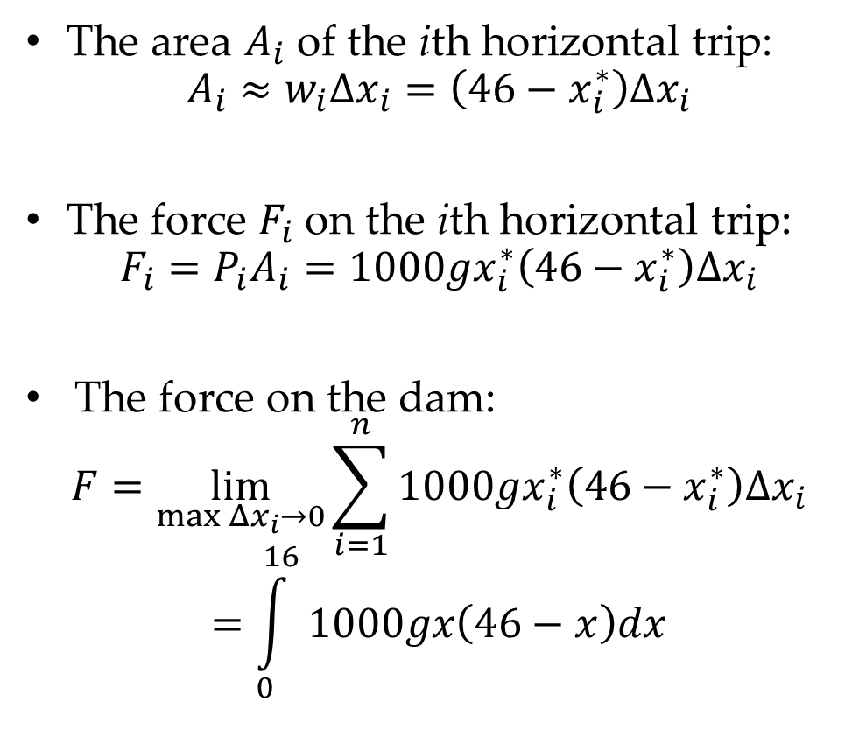
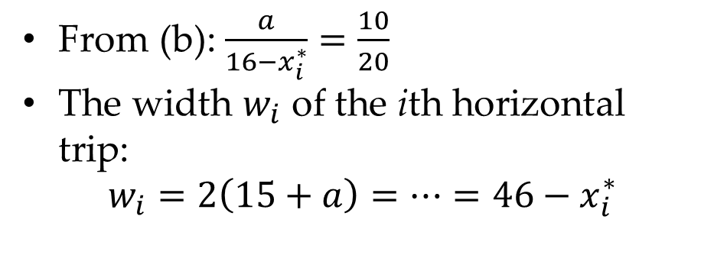
FLUID FORCE ON A VERTICAL SURFACE
The area $A_{i}$ of the ith horizontal trip:
$$A_{i}≈w_{i}Δx_{i}=\left(46−x_{i}^{∗}\right)Δx_{i}$$
The force $F_{i}$ on the ith horizontal trip:
$$F_{i}=P_{i}A_{i}=1000gx_{i}^{∗}\left(46−x_{i}^{∗}\right)Δx_{i}$$
The force on the dam:
$$F=\lim_{\max{Δx_{i}→0}}{\sum_{i=1}^{n}{1000gx_{i}^{∗}\left(46−x_{i}^{∗}\right)Δx_{i}}}$$
$$=\int_{0}^{16}{1000gx\left(46−x\right)dx}$$
From (b): $\frac{a}{16−x_{i}^{∗}}=\frac{10}{20}$
The width $w_{i}$ of the ith horizontal trip:
$$w_{i}=2\left(15+a\right)=…=46−x_{i}^{∗}$$

Slide 8
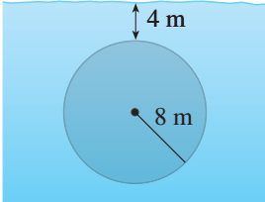
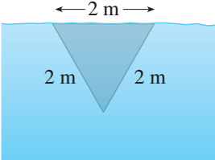
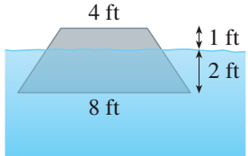
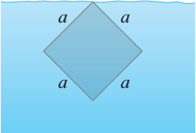
EXAMPLES
Example 3. A vertical plate is submerged (or partially submerged) in water and has the indicated shape. Explain how to approximate the hydrostatic force against one side of the plate by a Riemann sum. Then express the force as an integral and evaluate it.

Slide 9
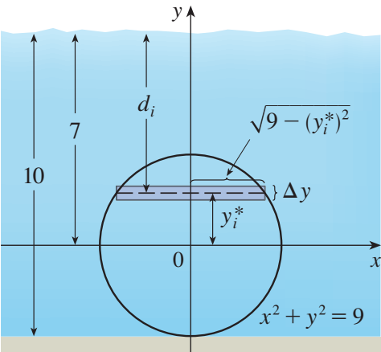
EXERCISES
1. Suppose that 2J of work is needed to stretch a spring from its natural length of 30 cm to a length of 42 cm.
How much work is needed to stretch the spring from 35 cm to 40 cm?
How far beyond its natural length will a force of 30 N keep the spring stretched?
2. Find the hydrostatic force on one end of a cylindrical drum with radius 3 ft if the drum is submerged in water 10 ft deep.

